Slide 1
PPI scoring R shiny app
5.8.2023

Slide 2
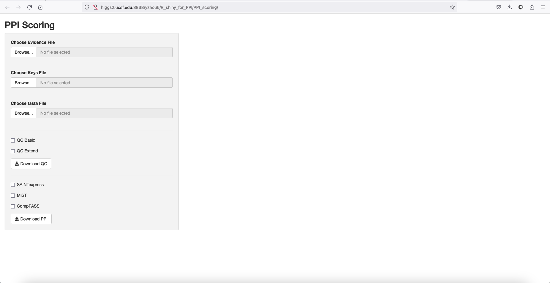
evidence.txt
keys.txt
.fasta

Slide 3
evidence.txt
keys.txt
.fasta
RawFile: The name of the RAW-file for which the mass spectral data was derived from.
IsotopeLabelType: 'L' for label free experiments ('H' will be used for SILAC experiments, see below)
Condition: The conditions names must follow these rules:
Use only letters (A - Z, both uppercase and lowercase) and numbers (0 - 9). The only special character allowed is underscore (_).
Very important: A condition name cannot begin with a number (R limitation).
BioReplicate: biological replicate number. It is based on the condition name. Use as prefix the corresponding Condition name, and add as suffix dash (-) plus the biological replicate number. For example, if condition H1N1_06H has too biological replicates, name them H1N1_06H-1 and H1N1_06H-2
Run: a unique number for all the MS runs (from 1 to the total number of raw files). It will be especially useful when having technical replicates. For example, in the table below, there are 2 technical replicates of the same biological replicate (Cal_33-1, technical replicates 1 and 2). A special case is SILAC experiments (H and L label are run simultaneously. See below to find out more)

Slide 4
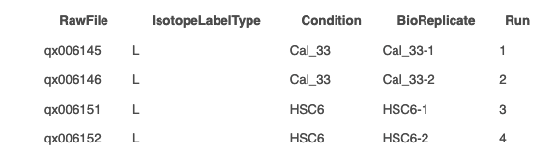
evidence.txt
keys.txt
.fasta
RawFile: The name of the RAW-file for which the mass spectral data was derived from.
IsotopeLabelType: 'L' for label free experiments ('H' will be used for SILAC experiments, see below)
Condition: The conditions names must follow these rules:
Use only letters (A - Z, both uppercase and lowercase) and numbers (0 - 9). The only special character allowed is underscore (_).
Very important: A condition name cannot begin with a number (R limitation).
BioReplicate: biological replicate number. It is based on the condition name. Use as prefix the corresponding Condition name, and add as suffix dash (-) plus the biological replicate number. For example, if condition H1N1_06H has too biological replicates, name them H1N1_06H-1 and H1N1_06H-2
Run: a unique number for all the MS runs (from 1 to the total number of raw files). It will be especially useful when having technical replicates. For example, in the table below, there are 2 technical replicates of the same biological replicate (Cal_33-1, technical replicates 1 and 2). A special case is SILAC experiments (H and L label are run simultaneously. See below to find out more)

Slide 5

evidence.txt
keys.txt
.fasta

Slide 6
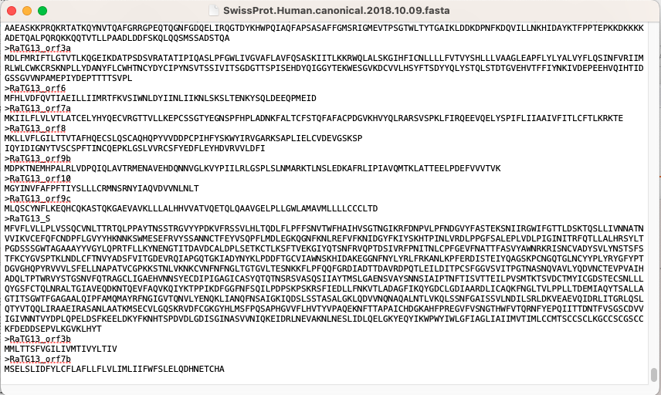
evidence.txt
keys.txt
.fasta
Don’t forget the empty row at the very end!
Notes:
http://higgs2.ucsf.edu:3838/yzhou5/R_shiny_for_PPI/PPI_scoring/

